Slide 1
Co-financed by the
European Fund for the Integration of Third-Country Nationals
Legal obstacles and opportunities for access to citizenship Rainer Bauböck (EUI) and Kristen Jeffers (UCD)

Slide 2
Citizenship Law Indicators Opportunities and Obstacles
57 indicators compare specific aspects of citizenship regimes across countries and time
45 basic indicators (e.g. extension of naturalisation to child)
6 intermediate indicators (e.g. all family-based naturalisation)
6 combined indicators: ius sanguinis, ius soli, ordinary naturalisation, special naturalisation, renunciation, withdrawal
Indicators measure the degree of inclusion or individual choice for target groups of provisions in citizenship laws: legal opportunities/obstacles to acquire or retain citizenship
Indicator scores range from 0 to 1 and 0 = least inclusion or freedom of choice for the target group
1 = widest inclusion of freedom of choice for the target group
Notes:
For descriptive analysis
For further analysis as dependent or independent variable
Not normative

Slide 3
Summary of Findings
Notes:
Europe = EU-27 + Croatia, Iceland, Macedonia, Moldova, Montenegro, Norway, Serbia, Switzerland, and Turkey

Slide 4
Ordinary Naturalisation
Notes:
Scores based on what is legislated as of 2011

Slide 5
Special Naturalisation (selected modes)

Slide 6
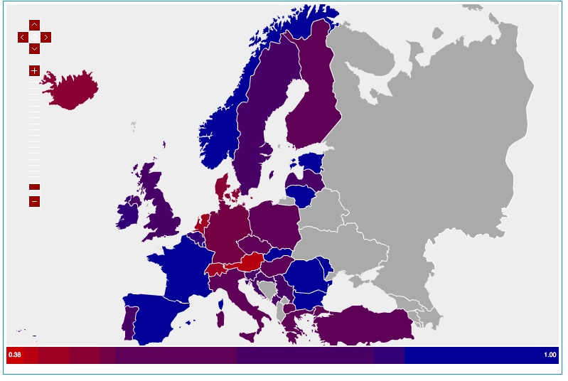
Ius Sanguinis

Slide 7
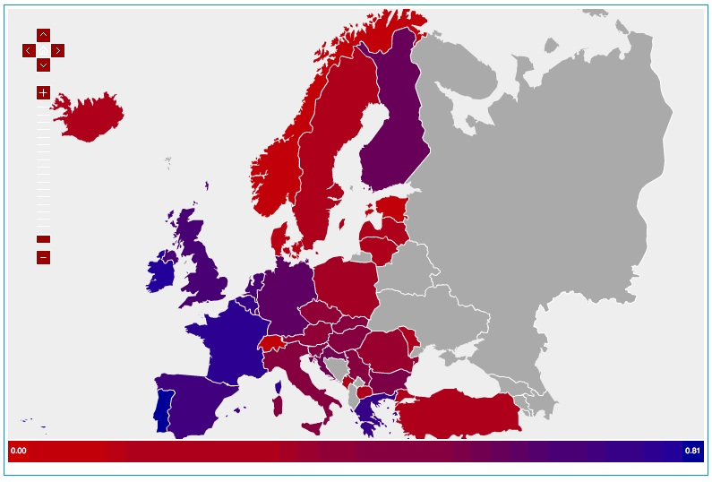
Ius Soli

Slide 8
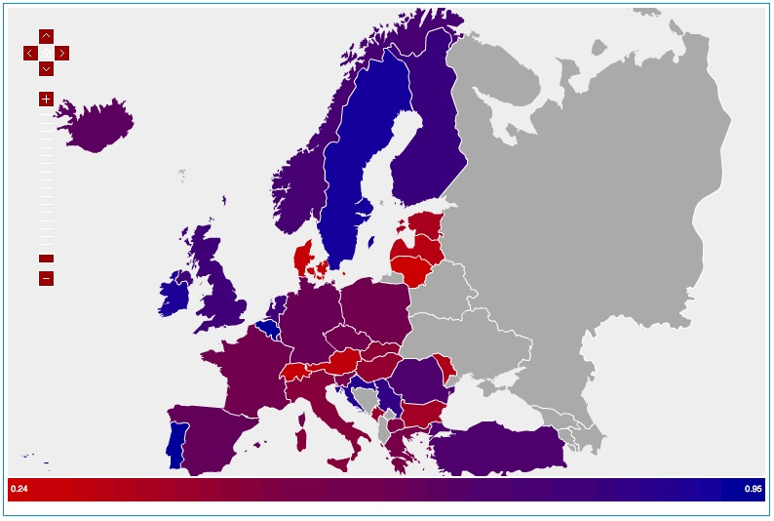
Ordinary Naturalisation

Slide 9
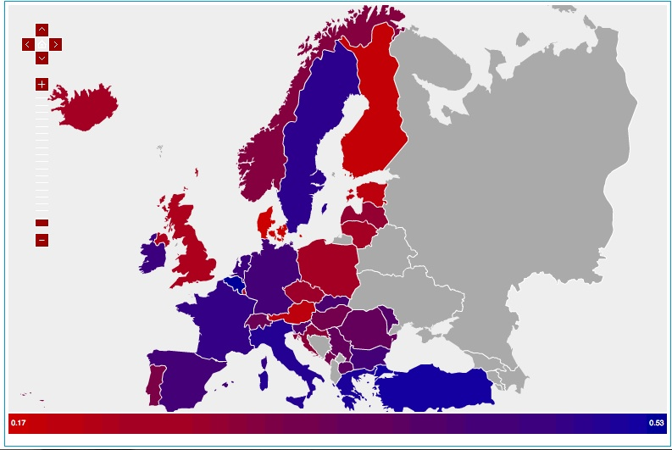
Special Naturalisation

Slide 10
Renunciation

Slide 11
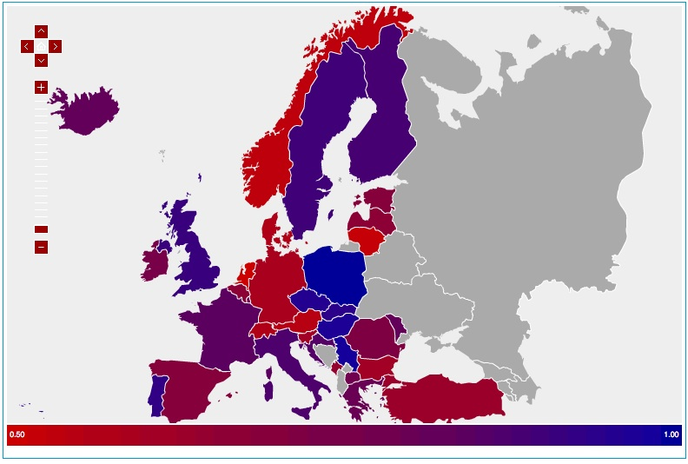
Involuntary Loss

Slide 12
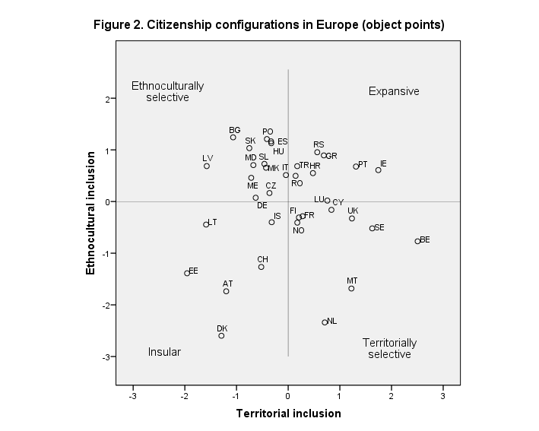
Citizenship Law Configurations

Slide 13
Conclusions
Strong variation in inclusiveness of citizenship laws
especially with regard to ius soli for 2nd and 3rd generations
and conditions for ordinary naturalisation
stronger inclusion of citizens abroad through ius sanguinis and restrictions on withdrawal
No EU legislative competence but three EU concerns
withdrawal of citizenship if it implies also loss of EU citizenship (CJEU Rottmann case). See e.g. German Optionspflicht
preventing massive creation of extraterritorial EU citizens through unconditional ius sanguinis and ancestry-based naturalisation
promoting access for EU citizens and third country nationals residing in the EU through ius soli, naturalisation and toleration of dual citizenship
Notes:
For descriptive analysis
For further analysis as dependent or independent variable
Not normative

