Slide 1
Co-financed by the
European Fund for the Integration of Third-Country Nationals
Administrative opportunities and
obstacles in naturalisation procedures Thomas Huddleston (MPG)

Slide 2
Citizenship Implementation Indicators (CITIMP)
38 indicators compare formal aspects of naturalisation procedure. These include all stages, from efforts by public authorities to inform applicants to the options to appeal a negative decision.
5 dimensions covered administrative procedure:
Promotion: how much do authorities encourage applicants to apply?
Documentation: how easily can applicants prove they meet the conditions?
Discretion: how much room do authorities have to interpret conditions?
Bureaucracy: how easy is it for authorities to come to a decision?
Review: how strong is judicial oversight of the procedure?
Notes:
independent variables for:
explaining the impact of citizenship laws on citizenship acquisition
explaining the impact of citizenship laws on post-acquisition outcomes (integration, participation, mobility)
dependent variables for testing explanations of why citizenship regimes differ and have changed over time (e.g. colonial experience leads to more liberal access to nationality)

Slide 3
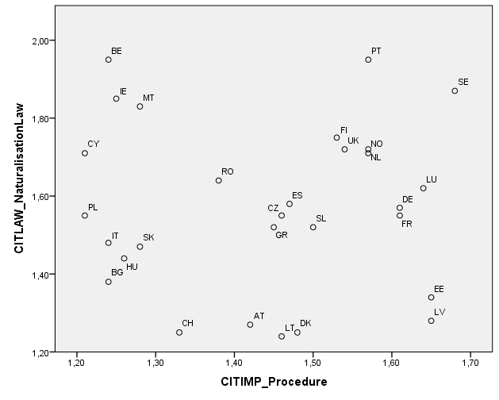
Summary of Findings
Positive link to certain extent between law (CITLAW) & procedure (CITIMP)
Unlike most, EE & LV have
many legal obstacles but
facilitate the procedure
Inclusive legislation is
undermined by obstacles
in procedures in BE**, IE,
CY, and MT.
**Procedure replaced as of 1.01.2013

Slide 4
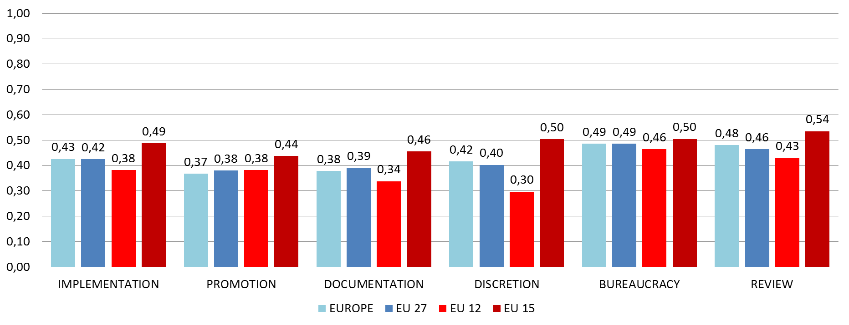
Summary of Findings
Limited promotion by state: basic materials & ‘normal’ costs
Demanding documentation, esp. from CoO & w/out exemptions
Generally discretionary procedures, but with some limits
Some bureaucracy, esp. for info, duration, & final decision
Basic review: right to reasoned decision & appeal, less so for ‘tests’

Slide 5
Promotion
Promotion linked to discretion, but not legal requirements
Opportunities:
Basic promotional materials, websites, and study guides
‘Normal’ costs for courses and tests (note: interviews often free)
Some sort of citizenship ceremony in most countries
Missed opportunities:
Hardly any state campaigns (see EE, LV, MK, Berlin, Hamburg)
Few promotional services (information, application-checking)
Promotion rarely targets society at large

Slide 6
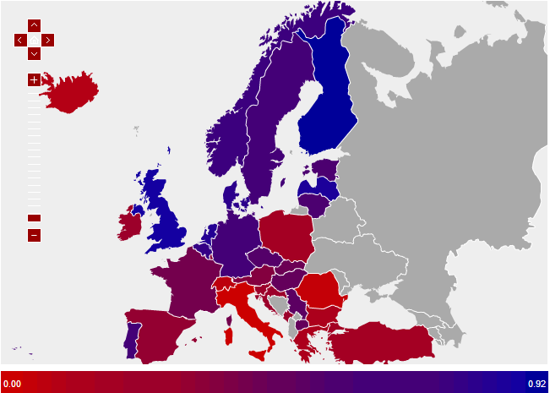
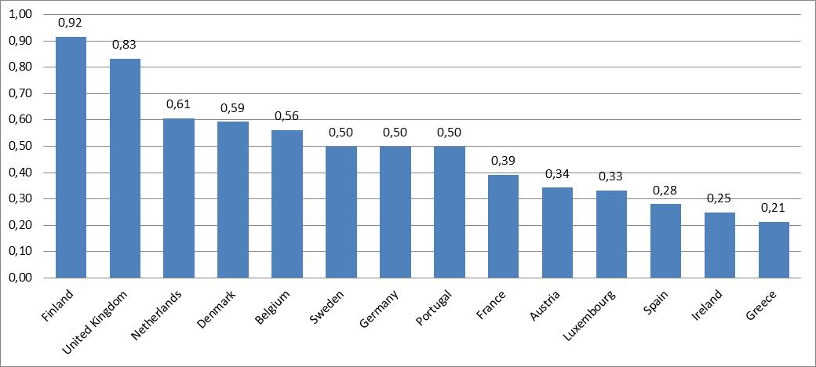
Documentation
Notes:
Documentation:
Easier N/NW EU, UK
Demanding in Central & South (-- PT, Baltics)
Also in FR & AT
Uneven for recent reformers (LU, GR, IE)

Slide 7
Documentation
Opportunities:
Relatively clear documentation for residence/ID
Some flexibility for language proof
Many exemptions for few countries with renunciation requirements
Obstacles:
Country of origin birth certificate or ID, translated & legalised
Weak and discretionary alternative means to prove identity
Few exemptions on language/integration test (mostly vulnerability)
Hardly any exemptions for criminal or income requirement

Slide 8
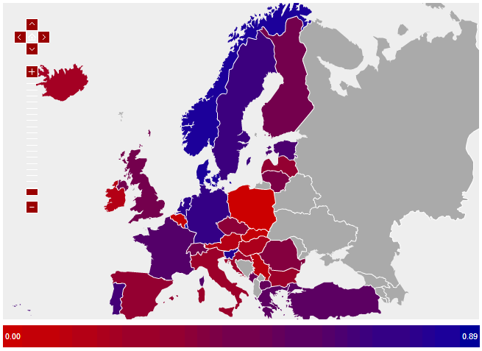
Discretion
Notes:
Wide discretion:
Discretionary in South & Central EU, AT, IE, UK
More rights-based in N/NW EU
Less discretionary in recent reformers

Slide 9
Discretion
Opportunities:
Tests in EU15: Less discretion & greater transparency
Limits on discretion in renunciation & criminal record requirements
Obstacles:
Generally discretionary procedure (rights-based in only 9 countries)
Additional discretionary grounds for rejection
Discretionary integration interviews in Central & Southern EU
Few language/integration tests from independent specialists

Slide 10
Bureaucracy
Bureaucracy linked to documentation & discretion
Opportunities:
Same specialised unit receives, checks, and decides on application, esp. in EU-15 countries
Decision taken at national level
Obstacles:
Data and advice needed from several authorities
Few procedural time limits and hardly any sanctions
Final decision often remains with minister/president; hardly any are independent (CA’s citizenship judges, BE Public Prosecutor’s Office)

Slide 11
Review
Opportunities:
Right to reasoned decision & appeal in most (recently BE, PL)
Appeal before courts on procedural & substantive aspects
Obstacles:
Short time limits (also long duration, little legal aid…)
Courts rarely can change the decision in merit (see FI, FR, LV, LU, ES)
Tests often missing either reasoned decision or right to appeal (weakest in Central & Southern Europe, FI, LU, NL, NO, PT, UK; strongest in FR, LV, ES, CH)

Slide 12
Conclusions
Major administrative opportunities
• Basic promotional materials • Some limits on discretion • Specialised authorities at national level • Right to reasoned decision & appeal
Major administrative obstacles
• Country of Origin documents • Uneven humanitarian & vulnerability exemptions
• Few time limits • Discretion, esp. Central & Southern Europe • Few campaigns
Law & procedure are generally linked, should be examined together (e.g. MIPEX)
Promotion may not be effective with major legal obstacles & wide discretion
Greater bureaucracy linked to demanding documentation & wide discretion
1997 Council of Europe Convention on Nationality norms on review & reasoned decision could apply not only to procedure, but also to related ‘tests’

